Slide 1
General Guidelines for Presentation
Slides should not be too heavy with content. Better to create point wise.
If you require more than one slide for any point, right click on that point slide then select duplicate slide and modify the duplicated slide.
Diagrams must be aligned at centre and clearly visible with caption.
All the mentioned fonts, font size, title content, etc should not change and strictly as per the given format and guidelines.

Slide 2

* All In One Formula List *
Vedanti Nandvikar - 21104024
Vishakha Mahajan - 21104126
Samiksha Deo - 21104124
Sonal Mallah - 21104096
~Prof. Manasi Choche

Slide 3
Contents
Introduction
Objectives
Scope
Features / Functionality
Project Outcomes
Technology Stack
Block Diagram/ Flow

Slide 4
Introduction
1.
In All In One Formula List you can access all the mathematical formulas in one place.
Formulas which are easy to understand and learn.
Problem Identified :
1. An inability to recall every formulas.
2. Difficulty to revise all formulas together.
Solution Proposed :
1. Quick and Easy access to every formula in one place.
2. Efficient way to Learn/Revise formulas

Slide 5
Objectives
2.
1. To achieve efficiency.
2. To build a user friendly interface.
3. To avail all formulas in one click.
4. To help users to learn formulas easily.
5. To reduce the time and efforts of user.
6. To revise the formulas in short period of time.

Slide 6
Scope
3.
1. Can be useful to Students/ Teachers/Parents.
2. Can be applied in Technical/Logical Fields.
3. Can be used by Every Person from Non-Technical Background.

Slide 7
Feature /Functionality
4.
1. Easy User Interface.
2. Display all the formulas in one page.
3. Easy to remember all the formulas.
4. All the formulas are upto date and precious.

Slide 8
Outcome of Project
5.
1. User needs to Register.
2. User can log in
3. User can Select for Topic
4. User can view the selected data.
5. User can access data multiple times.
6.User can logout.

Slide 9
Technology Stack
6.
1. - Java
2. - GUI- Netbeans
3. - Backend- MySql, PhpMyAdmin

Slide 10
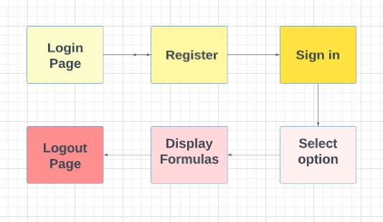
Block Diagram/ Flow Chart
7.

Slide 11
Thank You...!!

